Slide 1
Quiz
5 Apr 2017
PYNEH

Slide 2
Q1. A 6-year-old girl had a fall on level ground. She complained of pain over left forearms.
X-rays of both forearms were taken.
What are the injuries identified in this set of X-ray?
1. ____________________________________
2._____________________________________
What treatment will you recommend?
_________________________________

Slide 3
Q1 Fig 1a: Left Lateral

Slide 4
Q1 Fig 1b: Left AP

Slide 5
Q1 Fig 1c: right latera;

Slide 6
Q1 Fig 1d: right AP

Slide 7
Q2: M/51 back seat passenger of a car injured in RTA. He complained of abdominal and back pain.
X-rays of the lumbo-sacral spine were taken.
1.What injury is present in the LS spine X-ray?
2.What is the mechanism of injury?
3.What intra-abdominal injuries will you consider if the patient has persistent upper abdominal pain and develop hypotension later?

Slide 8
Q2 Fig 2a: AP L spine

Slide 9
Q2 Fig 2b: lat L spine

Slide 10
Q3: This 80-year-old woman has chest discomfort for 2 days. She has hypertension with treatment.
ECG is performed at Triage. BP at triage is 116/77
1. What are your ECG findings?
2. Which is the likely culprit vessel?
3. Which ECG feature is important for prognosis?

Slide 12
Q4: M/36 with ankle sprain
Refer to the ankle X-ray:
1. point out the abnormal findings
___________
___________
What might be the likely mechanism of injury
Which ligaments are involved?
____________
____________

Slide 13
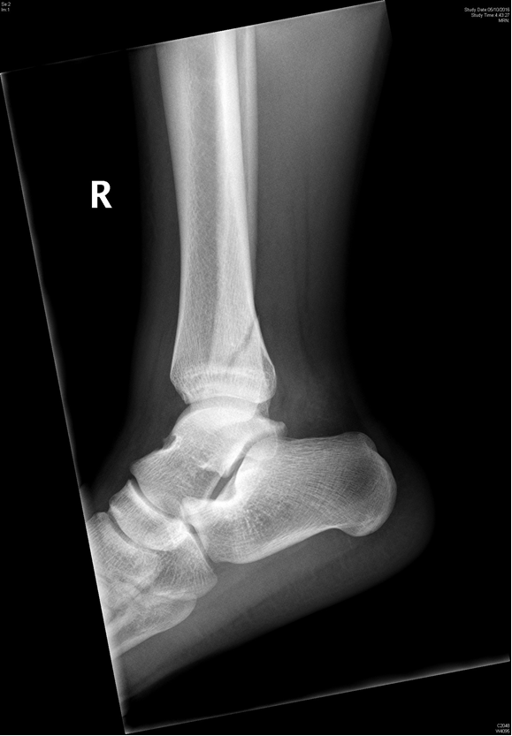
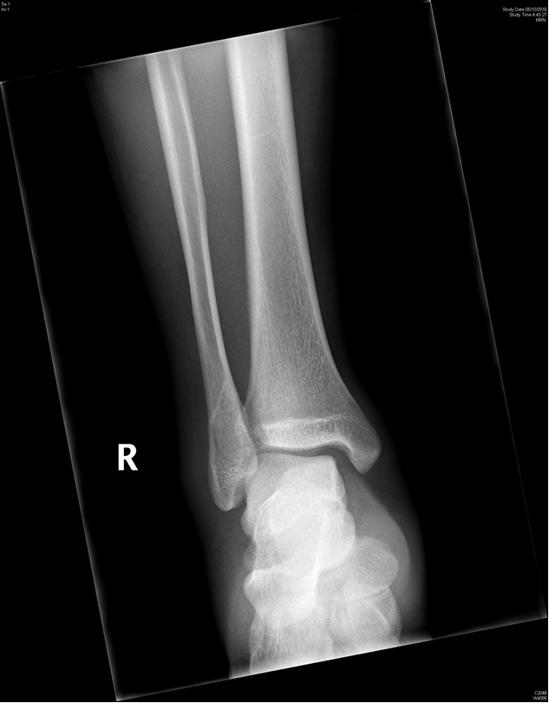
Fig. 8

